Slide 1
Your dream job – get the future started

Slide 2
Who I Am - Talking about my Personality
Find out what you are good at and
what you have to work on
by doing a personality test.
Present yourself: Talk about your personality.
about what you are good at.
about your aims.
Reflect on your presentation and listen to feedback.

Slide 3
My dream Job
Find out about different jobs.
Find out what you have to do.
where you can work.

Slide 4
My Curriculum Vitae (CV)
Find out how to write an English CV.
Find out the differences between a German and an English CV.
Find strengths and weaknesses in other people‘s CVs.
Write your own CV.

Slide 5
My Cover letter
Find out how to write a cover letter.
Find out the differences between a German and an English cover letter.
Find strengths and weaknesses in other people‘s cover letters.
Write your own cover letter.

Slide 6
My job interview
Find out how to survive a job interview by watching video clips.
Find out how to react to difficult questions.
Find out how to be polite.
Think about body language and give feedback to others.
Listen to feedback for your own job interview.

Slide 7
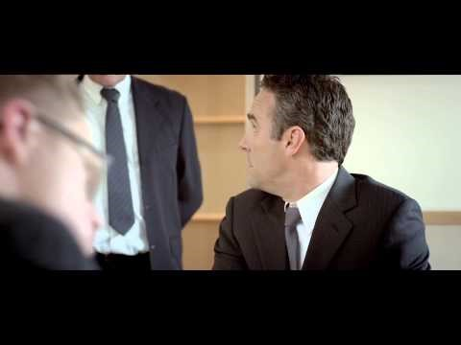
Whatever you have learned, something unexpected can always happen…

